Slide 1
Advent Adventures
Bringing the Season to Life for Children and Youth

Slide 2
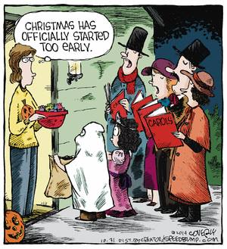
To lead kids through Catholic Advent...
You need to live the season in a Catholic way yourself – to be authentic.

Slide 3
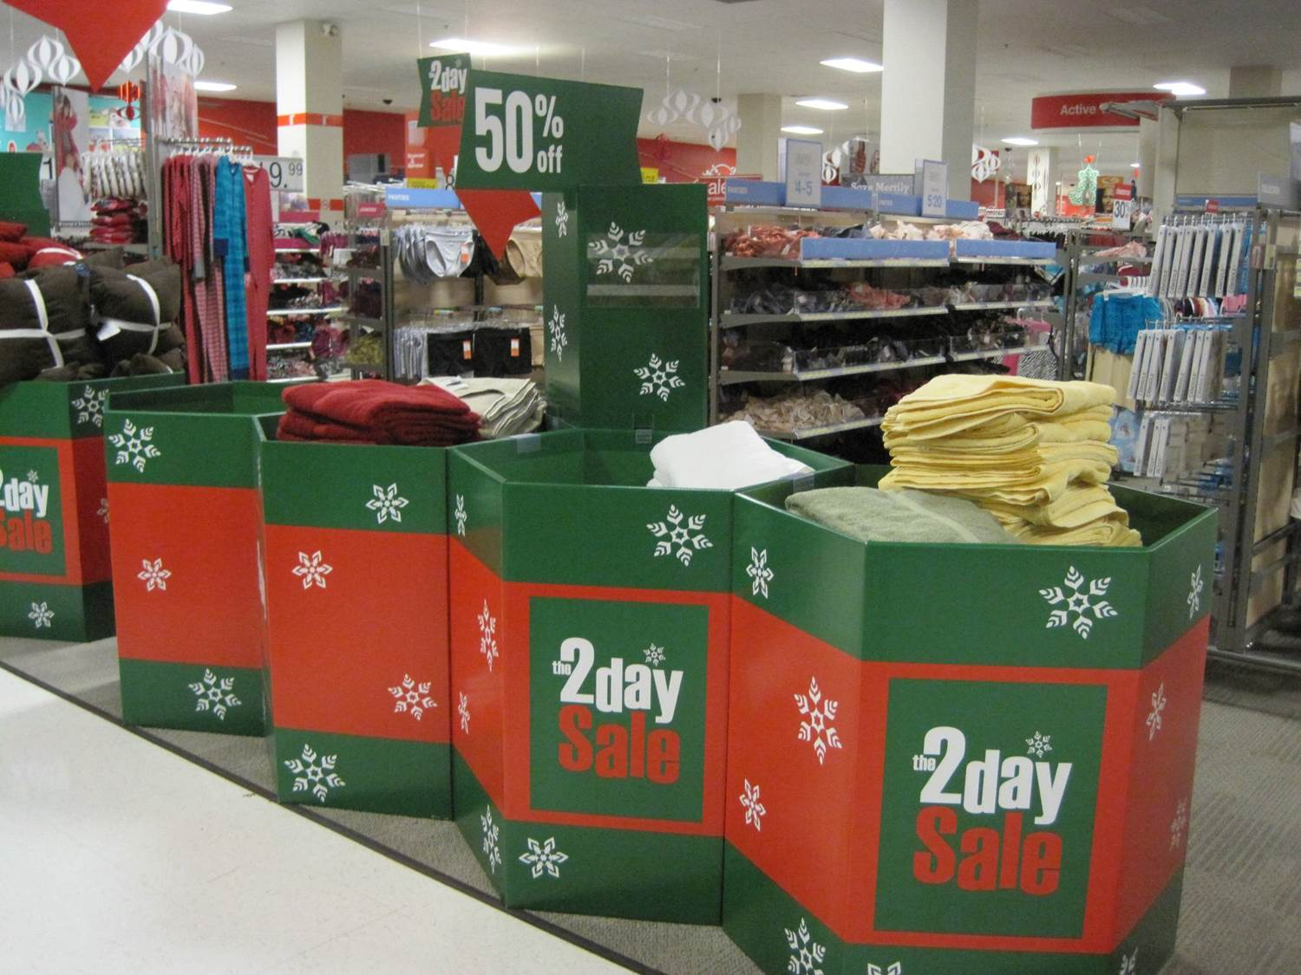
Advent is about waiting
For the Incarnation
For the Second Coming
BUT – the US consumer culture says December is “the Christmas Season”

Slide 4
We need to be countercultural
https://www.youtube.com/watch?v=vhBB5bwuzl4

Slide 5
What the Church says about Advent
“The Advent season is a time of preparation that directs our hearts and minds to Christ’s second coming at the end of time and also to the anniversary of the Lord’s birth on Christmas. ”
(USCCB Liturgical Year resources.)

Slide 6
The Three Comings of Christ
St. Bernard of Clairvaux:
1st Coming: as a human being living among men who saw and hated him. He came as our redemption: “in flesh and weakness”
2nd Coming: he will come at the end of time and all flesh shall see him. He will come as our life: “in glory and majesty”
The “middle coming” is invisible and in the present. He comes as our rest and consolation: “in spirit and in power”
(“If anyone loves me, he will keep my words, and the Father will love him, and we shall come to him. ”)

Slide 7
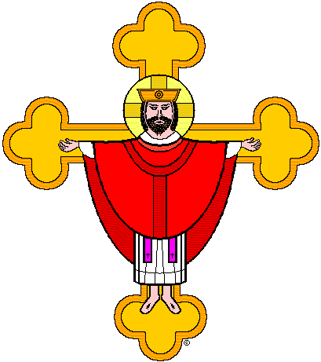
Making that accessible for kids
Jesus Christ the baby in the manger
Jesus Christ in the hearts of those who believe in him
Jesus Christ the King in heaven (who will come to earth)

Slide 8
The big question of Advent
What do we do while we are waiting?

Slide 9
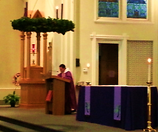
What do we do in church?
Purple vestments
Advent wreath
Prayers and songs about eager waiting
No “Glory to God” (we are waiting for the angels song at Christmas)

Slide 10
As we begin Advent…
Listen to the prayers at Mass:
“Grant your faithful, we pray, almighty God
the resolve to run forth to meet your Christ
with righteous deeds at his coming
so that, gathered at his right hand,
they may be worthy to possess the heavenly Kingdom
Through our Lord Jesus Christ, your Son……”
(Collect, 1st Sunday in Advent)

Slide 11
As we end Advent…
“Having received this pledge of eternal redemption
We pray, almighty God,
That as the feast day of our salvation draws ever nearer,
so we may press forward all the more eagerly
To the worthy celebration of the mystery of your Son’s Nativity.
Who lives and reigns for ever and ever…”
(Prayer after Communion, 4th Sunday)

Slide 12
For Reflection: what does it mean
to wait with eagerness and joy?

Slide 13
Symbols of Advent
Wreath
Purple (and blue)
Stars and nighttime sky
Looking toward the east
Alpha and Omega
Jesse Tree
O Antiphons
Empty manger

Slide 14
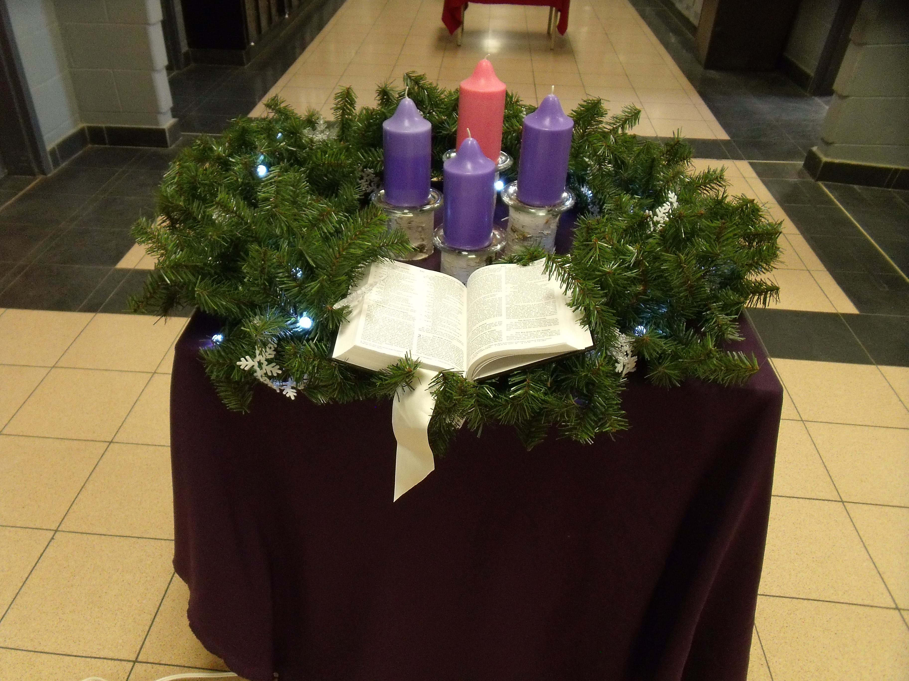
The wreath
Originated as a home devotion in Germany – made its way into churches.
Circle represents God’s unending love – and also eternity
The increasing light represents the approach of Jesus
The evergreens represent hope of eternal life

Slide 15
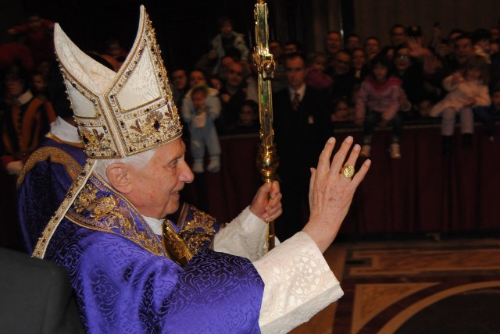
Purple (and blue)
The purple of Advent represents:
Waiting
Quiet
Royalty (“the King” is coming)
Blue is used as an accent – to remind us of Mary – who is also waiting

Slide 16
Stars and the night-time sky
Creator of the stars of night, thy people's everlasting light, Jesu, Redeemer, save us all, and hear Thy servants when they call…

Slide 17
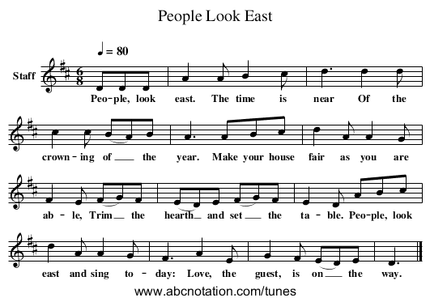
Looking to the East
“The King shall come when morning dawns…”

Slide 18
Alpha and Omega
Jesus Christ, the beginning and the end.
The Word who was present at Creation.
The King who will come at the end of time.

Slide 19
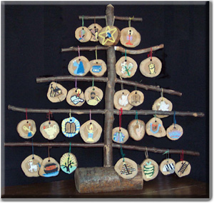
Jesse tree
The genealogy of Jesus, etc:
Adam, Noah, Abraham, Isaac, Jacob, Joseph, Moses, Joshua, Gideon, Samuel, David, Elijah, Hezekiah, Isaiah, Jeremiah, Nehemiah, John the Baptist, Mary, Elizabeth, Zechariah, Joseph, the Magi, Christ child, Chi-Rho.

Slide 20
The empty manger

Slide 21
O Antiphons
Begin on December 17th
December 17: O Sapientia (O Wisdom)
December 18: O Adonai (O Lord)
December 19: O Radix Jesse (O Root of Jesse)
December 20: O Clavis David (O Key of David)
December 21: O Oriens (O Dayspring)
December 22: O Rex Gentium (O King of the nations)
December 23: O Emmanuel (O With Us is God)
(See O Antiphon house instructions on Pinterest)

Slide 22
Or...

Slide 23
What to do in Religious Education
Teach about the Liturgical year as Advent begins
Display an Advent wreath and purple cloth on your prayer table
Pray around the wreath, using the invocation: “Come, Lord Jesus”
Use the “O Antiphons” after December 17 (even if it’s only once)
Plan hands-on Advent crafts (See Pinterest for options)
Do not spend Advent practicing for a Christmas program.
Plan Christmas parties for the Christmas season.

Slide 24
What can you send home to families?
Instructions for a family Advent wreath (and the blessing)
Encourage nightly prayer around Advent wreath
Suggest family charity projects
Send instructions for an Advent calendar with scripture connections – not Santas)
Suggest families wait to put up their Christmas tree to keep focus on the wreath. Send home the order of blessing of the Christmas tree
Encourage them to set up the empty stable – have Mary and Joseph, shepherds, start their journey (And after Christmas, start the 3 Kings moving toward Epiphany)

Slide 25
Ideas, patterns & instructions
http://www.pinterest.com/jdonliturgy/advent-crafts-classroom-ideas/
Username: Joyce Donahue or pinterest.com/jdonliturgy

Slide 26
The Liturgical Catechist
http://theliturgicalcatechist.weebly.com/
https://www.facebook.com/TheLiturgicalCatechist

